Slide 1
Module 1:
Introduction to Azure Concepts and Core Azure Services

Slide 2
Module 1: Lesson 8
Overview of Azure Database and Analytics Services

Slide 3







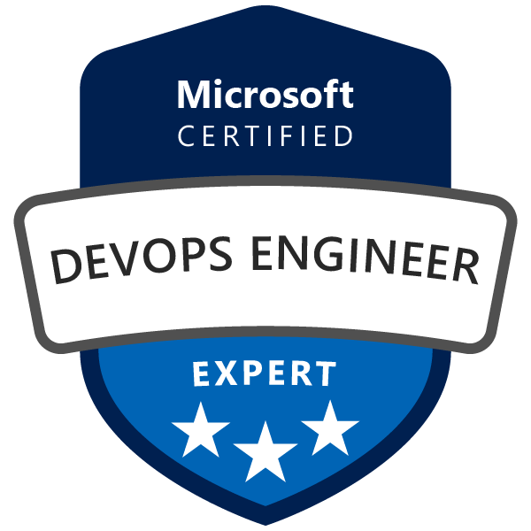
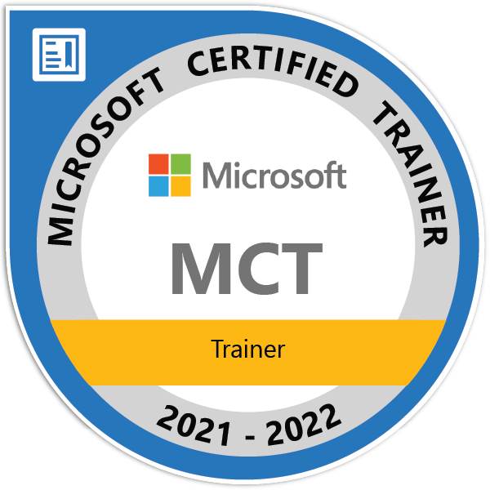
About The Presenter
Mario Dietner
Senior DevOps Consultant, Trivadis AG – part of Accenture
Azure DevOps, Cloud and Application Dev > 15 years of Experience
Microsoft Certified Trainer (M-AZ-400)
Community Builder, Opensource Contributor
Climber, Alpinist, Sports and Health Enthusiast

Slide 4


Lesson 2: Overview
This lesson will cover
Overview of Azure Database Services
Migrating Database Workloads to Azure
Overview of Analytics Services
Exam preparation (Q/A)

Slide 5
Lesson 2: Overview
This lesson will cover
Overview of Azure Database Services
Cosmos DB
MySQL
PostgreSQL
SQL Managed Instance
Migrating Database Workloads to Azure
Overview of Analytics Services
Exam preparation (Q/A)

Slide 6

Cosmos DB
Multi-Model, NoSQL Database Service
SLA, Always On
Consistency levels
Stores data in ARS (Atom-Record-Sequence)
Data is Abstracted over API
Choices: SQL, MongoDB, Cassandra, Tables, Gremlin

Slide 7


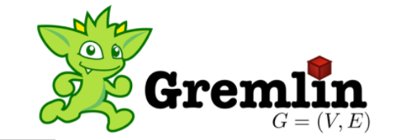
Cosmos DB - NoSQL
Not Only SQL
More flexible than Relation Databases
Schemeless Design
Suitability depends on the problem it must solve
Distributed System consistency based on the CAP Theorem
Consistent
Available
Partition/Fault Tolerant
Consistency
AC
CP
CAP
Partition Tolerance
Availability
AP

Slide 8
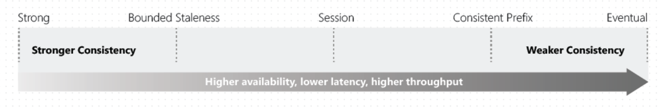
Cosmos DB
Consistency Levels
PACELC Theorem
Supports five tunable consistency levels that allow for tradeoffs between C/A during P, and L/C during E

Slide 9
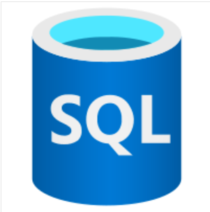
Azure SQL Database
Azure SQL Database PaaS database engine
Latest Stable SQL Server Version
Supported: patching, upgrading, backups and monitoring
99.99%-99.995% Service Availability
Relational Data + Non-Relational Structures (Graphs, Json, spatial, XML)
Migration from onPrem to Cloud with Azure Database Migration Service

Slide 10
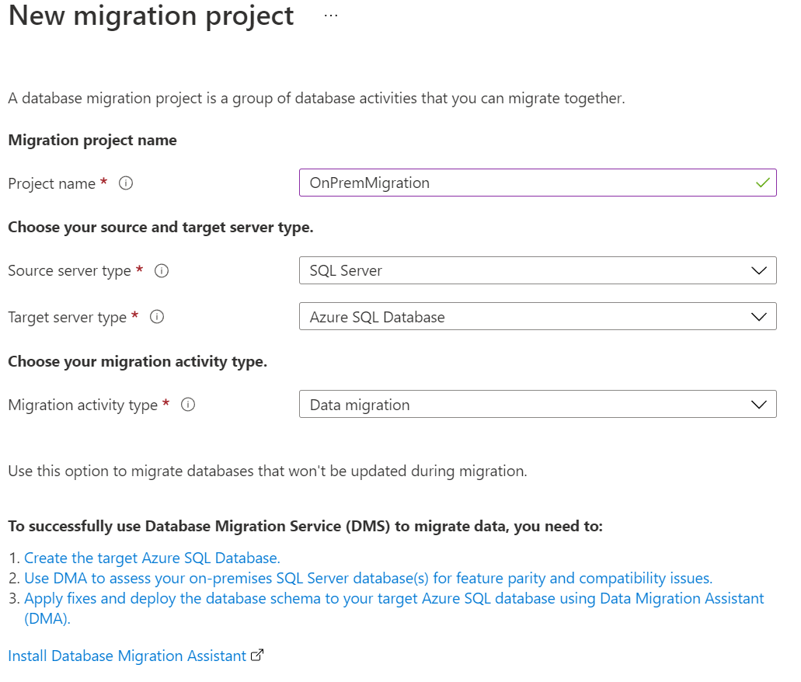
Azure Database Migration Services
SQL Server
Mongo DB
MySQL
PostgreSQL
AWS RDS for SQL Server
AWS RDS for PostgreSQL

Slide 11

Azure Database for MySQL
MySQL Community Edition database engine, (ver 5.6, 5.7, 8.0)
99.99% SLA
Can be used to support e.g., LAMP Application Architectures
Backup & Restore up to 35 days
Data Protection at-rest & in-motion
Migrate by using Azure Database Migration Service or MySQL Workbench

Slide 12
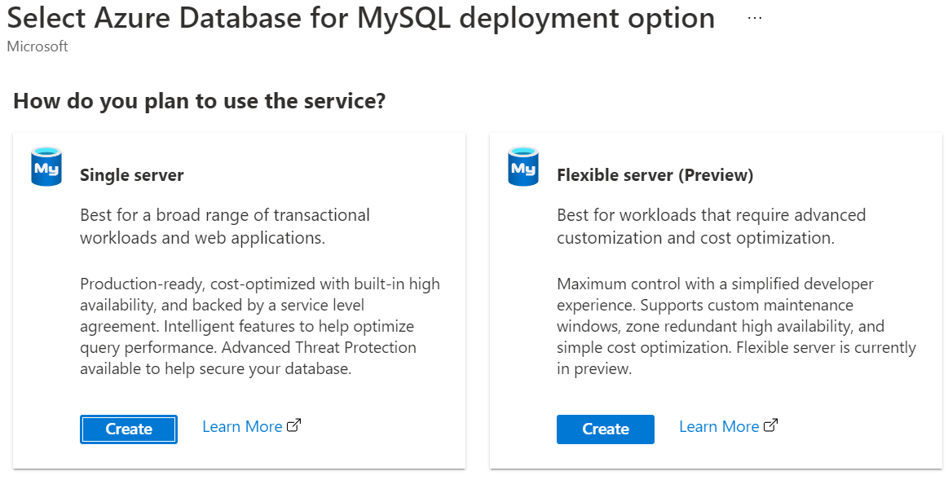
Single Server VS Flexible Server

Slide 13
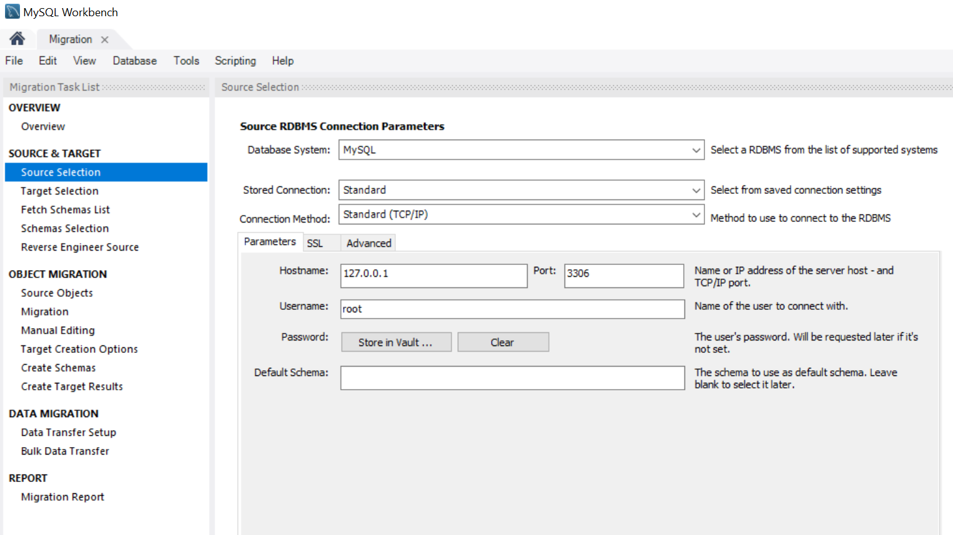
MySQL Workbench for Migration

Slide 14

Azure Database for PostgreSQL
Community version of the open-source PostgreSQL database engine
99.99% SLA
software patching, automatic backups, monitoring, and security
Automatic backups up to 35 days point-in-time-restore
Data Protection at-rest and in-motion
Single Server
Many pricing tiers with the possibility to scale vertically
Monitoring and alerting
Dynamic scalability: only pay for what you need
Hyperscale (Citus)
Horizontal scalability
Sharding

Slide 15
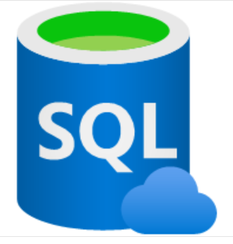
Azure SQL Managed Instance
All Features that Azure SQL + more
99.99% Service Availability
Collation for Azure SQL DB is only SQL_Latin1_General_CP1_CI_AS
Cross-Database transactions
Machine Learning
https://docs.microsoft.com/en-us/azure/azure-sql/database/features-comparison

Slide 16

Azure Synapse Analytics
Enterprise Analytics Service Platform
Integrability with other Azure Services
Cosmos DB, Power BI, Azure ML
Integrate and manage data from different data sources
SQL, Spark, ETL/ELT, OnPrem
SQL Pools
Consumes Data Warehouse
Spark Pool
Processes and Notebooks
Python, SQL, C# for data processing
Serverless
Execution of SQL Statements
Pay for consumption only

Slide 17

Azure HDInsight
Fully managed Apache Hadoop Service in Azure Cloud
Most Popular Frameworks support: Hadoop, Spark, Hive, LLAP, Kafka, Storm, R
Capabilities
Scalable
Secure & Compliant
Monitoring
Global Availability
Scenarios
Batch Processing
Data Warehousing
IOT
Data Science
Hybrid

Slide 18

Azure Databricks
Data Analytics Platform, optimized for Azure Cloud
Apache Spark based
Cluster configuration in Azure Platform
Environments:
Databricks SQL – SQL Queries on Data Lake
Databricks Data Science & Engineering – Interactive workspace collaboration between data engineers, scientists and ML engineers
Databricks Machine Learning – End2End ML environment for experiment tracking, model training, feature development etc.

Slide 19

Azure Data Lake Analytics
Distributed Analytics Service
Unstructured and structured data analysis
LET - Load, Extract, Transform
Write queries to transform your data and extract valuable insights
U-SQL query language
Pay per job basis
Auto scale up
Azure Data Lake Storage Gen1
Does not work with Azure Data Lake Storage Gen2

Slide 20




Prepare for The Exam (Q/A)
Your development team is interested in writing Graph-based applications that take advantage of the Gremlin API. Which option would be ideal for that scenario?
Your development team is interested in writing Graph-based applications that take advantage of the Gremlin API. Which option would be ideal for that scenario?
Azure SQL Database
Azure Databricks
Azure Cosmos DB
Azure Database for PostgreSQL

Slide 21
Your Company is using LAMP stack for several of its websites. Which option would be ideal for migration?
Azure Cosmos DB
Azure Database for PostgreSQL
Azure Database for MySQL

Slide 22

Summary
This lesson has covered
Overview of Azure Database Services
Migrating Database Workloads to Azure
Overview of Analytics Services
Exam preparation (Q/A)
Next Lesson:
Resources: Microsoft Docs &
Microsoft Learning
Notes:
How Cloud Can Help DevOps Transformation

